Slide 1
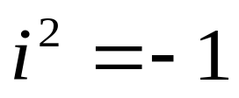
10.1 Complex Numbers
Definition:
A complex number is an ordered pair of real numbers, denoted either by (a, b) or a+bi, where

Slide 2
EXAMPLE 1
Ordered pair | Equivalent Notation
(3, 4) (-1, 2) (0, 1) (2, 0) (4, -2) | 3+4i -1+2i 0+ i 2+0i 4+(-2)i

Slide 3
EXAMPLE 2

Slide 4
Definition:
The complex numbers, a+bi and c+di, are defined to be equal, written
a+bi=c+di
If a=c, b=d.
**********************************
(a+bi)+(c+di)=(a+b)+(c+d)i (2)
(a+bi)-(c+di)=(a-c)+(c-d)i (3)
k(a+bi)=(ka)+(kb)i (4)

Slide 6
EXAMPLE 3
If z1=4-5i, z2=-1+6i, find z1+z2, z1-z2, 3z1, and –z2.
Solution:
z1+z2=(4-5i)+(-1+6i)=(4-1)+(-5+6)i=3+i
z1- z2=(4-5i)-(-1+6i)=(4+1)+(-5-6)i=5-11i
3z1=3(4-5i)=12-15i
-z2=(-1)(-1+6i)=1-6i

Slide 7
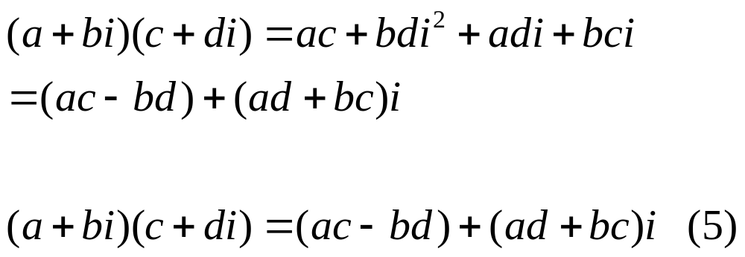

Slide 8
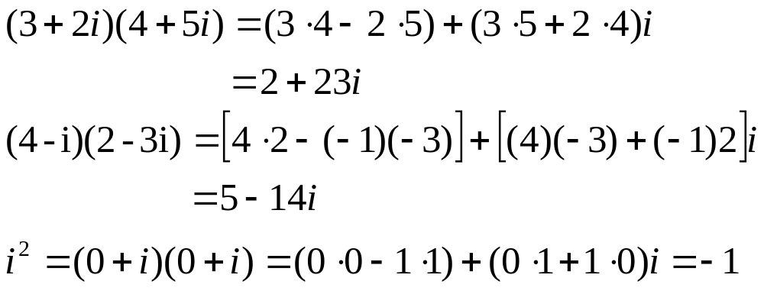
EXAMPLE 4

Slide 9



Example 5
Multiplication of Complex Numbers
REMARK : Unlike the real numbers, there is no size ordering for the complex numbers. Thus, the order symbols <, ,>,and are not used with complex numbers.

Slide 10
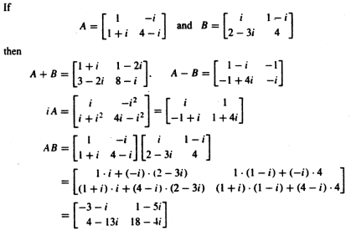
Example 6
Matrices with Complex Entries

Slide 11
10.2 DIVISION OF COMPLEX NUMBERS

Slide 12

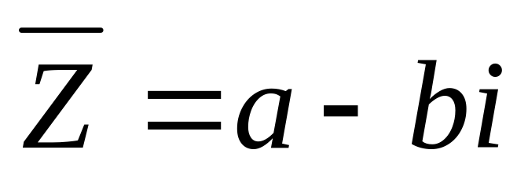
Complex Conjugates
If z= a+bi is any complex number, then the complex conjugate of z (also called the conjugate of z) is denoted by the symbol and is defined by :

Slide 13
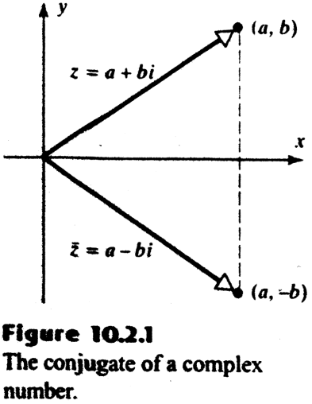
Complex Conjugates(Cont.)
In words, is obtained by reversing the sign of the imaginary part of z. Geometrically, is the reflection of z about the real axis(figure 10.2.1)

Slide 14
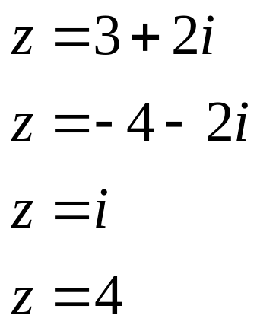
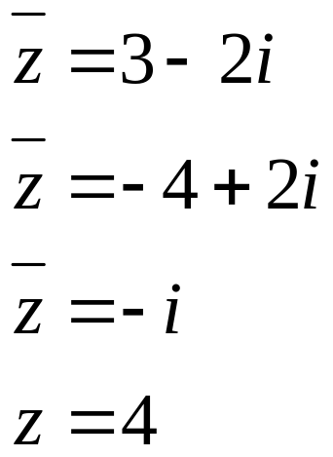
Example 1
Examples of Conjugates
Remark : The last line in Example 1 illustrates the fact that a real number is the same as its conjugate. More precisely,it can be shown(Exercise 22) that z = if and only if z is a real number.

Slide 15
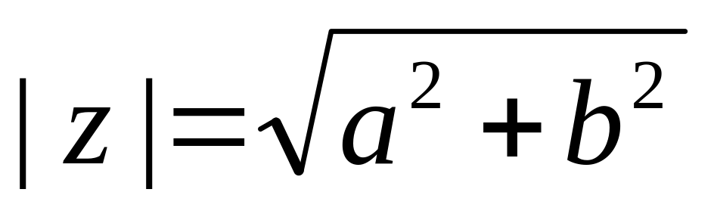
Definition
The modulus of a complex number z=a+bi, denote by |z|, is defined by
(1)

Slide 16
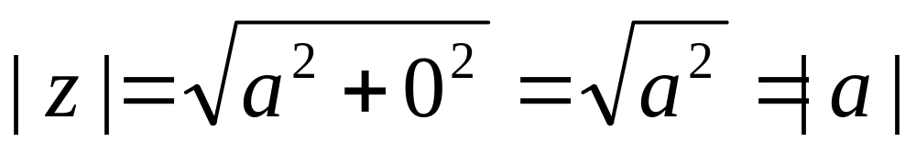
Definition(cont.)
If b = 0, then z = a is real number,and
So the modulus of a real number is simply its absolute value, Thus,the modulus of z is also called absolute value of z.

Slide 17
Example 2
Find |z| if z = 3 – 4i.
Solution :
From (1) with a = 3 and b = -4,

Slide 18
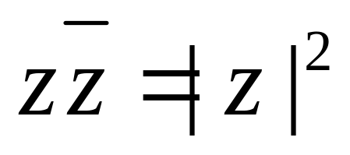
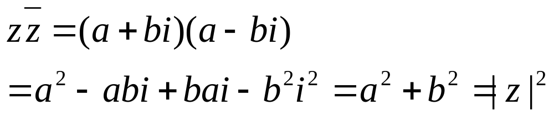
Theorem 10.2.1
For any complex number z.
Proof :if z = a+bi,then

Slide 19
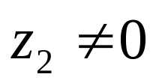
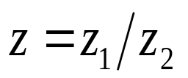
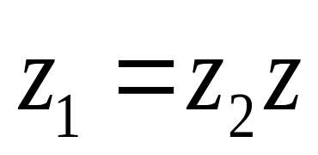
Division of Complex Numbers
We now turn to the division of complex numbers.
Our objective is to define division as the inverse of multiplication.
Thus,if ,then our definition of should be such that :
(2)

Slide 20
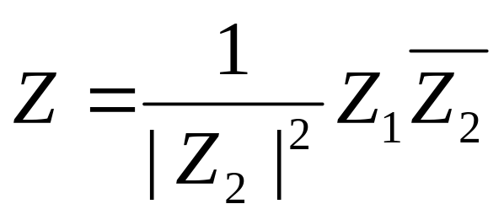
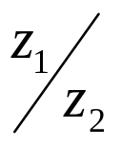


Theorem 10.2.2
For any complex number z.
Remark : To remember this formula, multiply
numerator and denominator of by :

Slide 21
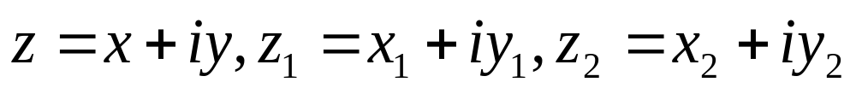

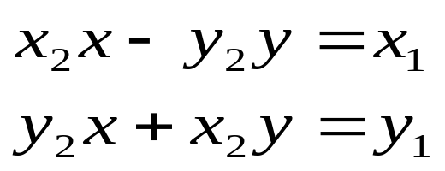
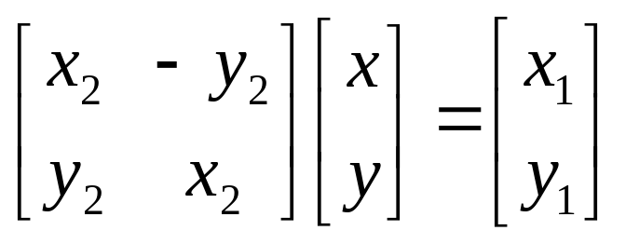
Theorem 10.2.2
Proof : Let
Then (2) can be written as :
or
Or, on equating real and imaginary parts,
or

Slide 22
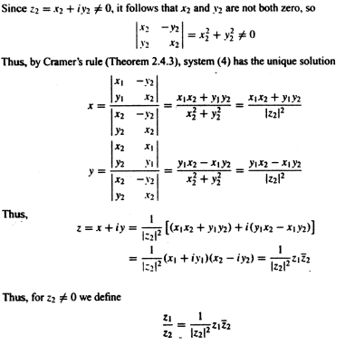
(5)

Slide 23
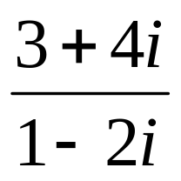
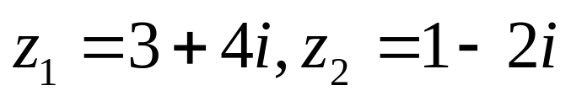

Example 3
Express in the form a+bi.
Solution :
From (5) with

Slide 24

Example3 (cont.)
Alternative Solution. As in the remark above, multiply numerator and denominator by the conjugate of the denominator :

Slide 25

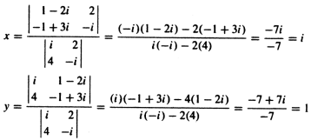
Example 4
Use Cramer`s rule to solve
Solution :
Thus, the solution is x=i, y=1-i.

Slide 26



Theorem 10.2.3
For any complex numbers z, and
We prove(a) and leave the rest as exercises

Slide 27
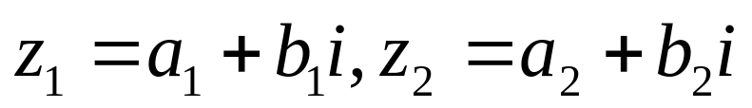


Theorem 10.2.3
Proof(a). Let ; then
Remark : it is possible to extend part(a) of Theorem. 10.2.3 to n terms and part(c) to n factors,More precisely,

Slide 28
10.3 POLAR FORM OF A COMPLEX NUMBER

Slide 29


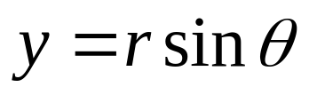


Polar Form
If z = x + iy is a nonzero complex number, r = |z| and measures the angle from the positive real axis to the vector z,then ,as suggested by figure10.3.1
(1)
So that z = x+iy can be written as
or
(2)
Ths is called a polar form of z.

Slide 30
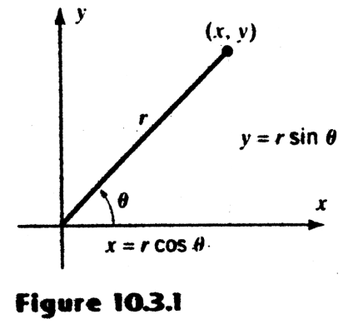
Polar Form(cont.)

Slide 31
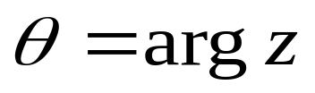


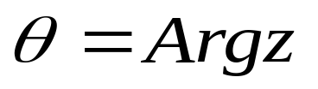
Argument of a Complex Number
The angle is called a polar form of z and is denote by
The argument of z is not uniquely determined because we can add or subtract any multiple of from to produce another value of the argument. However, there is only one value of the argument in radians that satisfies
This is called the principal argument of z and is denote by :

Slide 32
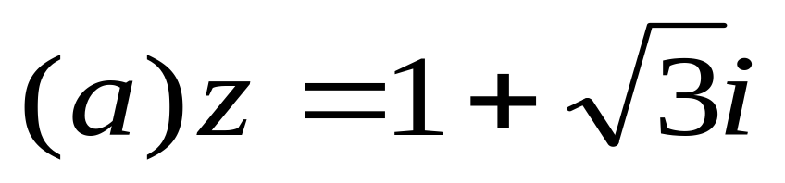
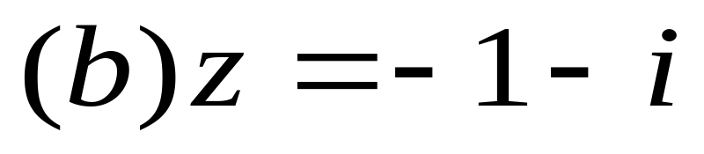
Example 1
Express the following complex numbers in polar form using their principal arguments :

Slide 33
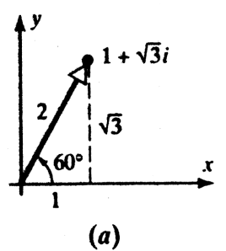
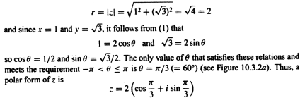
Example 1(cont.)
Solution(a) : The value for r is

Slide 34
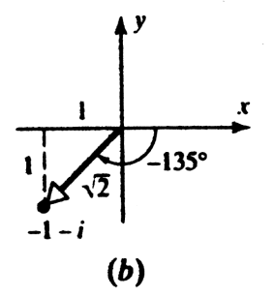


Example 1(cont.)
Solution(b) : The value for r is

Slide 35


Multiplication and
Division Interpreted Geometrically
We now show how polar forms can be used to give geometric interpretations of multiplication and division of complex numbers, Let
Recalling the trigonometric identities
(3)

Slide 36
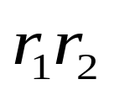

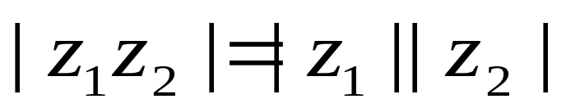
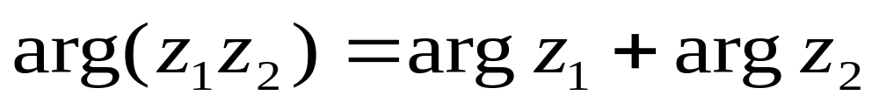
Multiplication and
Division Interpreted Geometrically
Which is a polar form of the complex number with modulus and argument
Thus, we have shown that
(4)
and

Slide 37
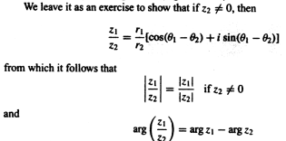
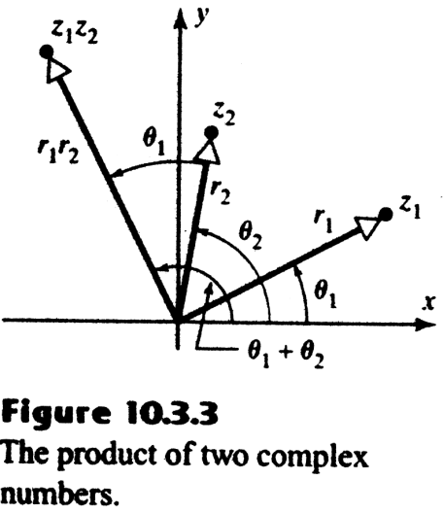
Multiplication and
Division Interpreted Geometrically
In words,the product of two complex number is obtained by multiplying their moduli and adding their arguments(figure10.3.3)
(5)
In words,the quotient of two complex number is obtained by dividing their moduli and subtracting their arguments(in the appropriate order.)

Slide 38
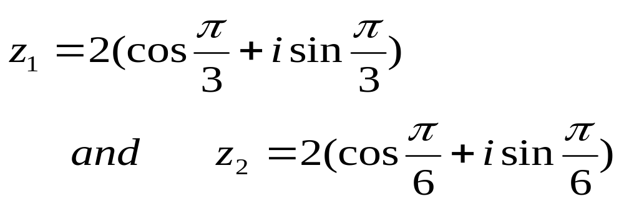
Example 2
Let
Polar forms of these complex numbers are

Slide 39
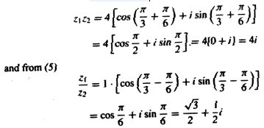
Example 2(cont.)
(verify) so that from(3)
and from(5)

Slide 40
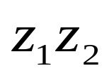




Example 2(cont.)
As a check, we calculate and directly without using polar forms for and :
Which agrees with our previous results

Slide 41
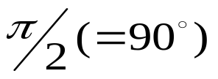

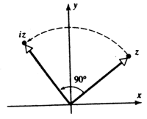
Example 2(cont.)
The complex number i has a modulus of 1 and an argument of ,so the product iz has the same modulus as z,but its argument is greater than that of z.
In short,multiplying z by i rotates z counterclockwise by(figure 10.3.4)
Figure10.3.4

Slide 42

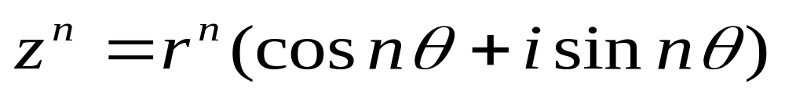

Demoivre`s Formula
If n is a positive integer and
Then from formula(3),
or
(6)
Moreover, (6) also holds for negative integer if
(see Exercise 2.3)

Slide 43

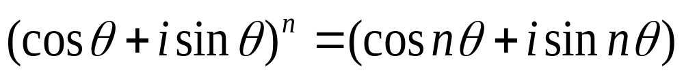
Demoivre`s Formula
In the special case where r=1, we have
,so (6) become
(7)
Which is called DeMoivre`s formula.Although we derived(7) assuming n to be a postive integer, it will be shown in the exercises that this formua is valid for all integers n.

Slide 44
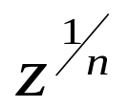

Finding nth Roots
We denote an nth root of z by ,If ,then we can derive formulas for the nth roots of z as follows.
Let
If we assume that w satisfies (8), then it follows from (6) that

Slide 45
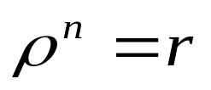
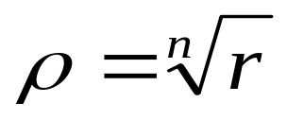







Finding nth Roots
Comparing the moduli of the two sides, we see that
Where denotes the real positive nth root of r. Moreover, in order to have the equalities and in (9), the angles and must either be equal or differ by a multiple of ,that is

Slide 46


Finding nth Roots
Thus, the value of that satisfy (8) are given by

Slide 47


Finding nth Roots
Although there are infinitely many values ofk, it can be shown(see Exercise 16) that k = 0,1,2……n-1 produce distinct values of w satisfying (8), but all other choices of k yield duplicates of these. There, there are exactly n different nth roots of ,and these are given by

Slide 48

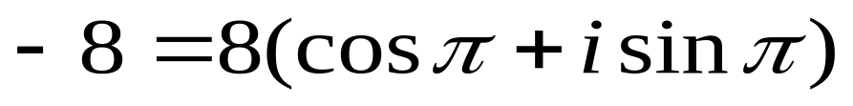
Example 3
Find all cube roots of -8
Solution :
Since –8 lies on the negative real axis, we can use as an argument. Moreover, r=|z|=|-8|=8, so a polar form of –8 is

Slide 49


Example 3
From(10) with n=3 it follows that
Thus, the cube roots of –8 are

Slide 50





As shown in figure 10.3.5, the three cube roots of –8 obtained in Example3 are equal spaced radians apart around the circle of radius 2 centered at the origin. This is not accidental. In general, it follows from Formula(10) that the nth roots of z lie on the circle of radius ,and are equally spaced radians apart.Thus,once one nth root of z is found,the remaining n-1 roots can be generated by rotating this root successively through increments of radians.

Slide 51

Example 4
Find all fourth roots of 1
Solution :
We could apply Formula(10), Instead, we observe that w=1 is one fourth root of 1, so that the remaining three rots can be generated by rotating this root through increments of
From Figure 10.3.6 we see that the fourth roots of 1 are
1, I, -1, -i

Slide 52



Complex Exponents
In more detailed studies of complex numbers, complex exponents are defined, and it is proved that
(11)
Where e is an irrational real number given approximately be e=2.71828……(For readers who have studied calculus, a proof of this result is given in Exercise 18).
it follows from(11) that the polar form
Can be written more briefly as
(12)

Slide 53

Example 5
In Example 1 it was shown that
From (12) this can also be written as

Slide 54


Example 5
It can be prove that complex exponents follow the same laws as real exponents, so that if
Are nonzero complex numbers then
But these are just formulas (3) and (5) in a different notation.

Slide 55


Example 5
we conclude this a section with a useful formula for in polar notation. if

Slide 56


Example 5
In the special case there r = 1, the polar form of z is
,and (14) yields the formula

